Slide 1
Case Study
Beers & Breweries
Notes:
Speaker: Rajesh
Firstly, Mr. CEO, we would like to thank for giving this opportunity to study your Beers and Breweries business and taking the time from your busy schedule to listen to our presentation.

Slide 2
Scope
Target audience: Budweiser CEO and CFO executives
Breweries by state
Median ABV and IBU by state
Highest level of ABV and IBU by state
Understand detailed information related to ABV
Explain relationship between ABV and IBU
Notes:
Clean up bullet points to be more crisp
Speaker: Rajesh
Notes: The primary focus of this presentation is to address some of the key questions.
How many Breweries are there by state
Median Alcohol by Volume (ABV) and beer bitterness (IBU) by state
Which states has beers with highest level of alcohol by volume and bitterness
We will also present detailed information related to alcohol by volume and will also address the relation between alcohol by volume and bitterness

Slide 3
Case Study Data
Beers
Breweries
2410 US craft beers
Beer ID
Beer names
Alcohol By Volume (ABV)
International Bitterness Units (IBU)
Brewery ID
Style
Ounces
558 US breweries
Brewery ID
Brewery names
City
State
Notes:
Reduce to main points not whole data set
Speaker: Rajesh
Notes: Our analysis is based upon the two datasets, beers and breweries, which is provided by Budweiser

Slide 4
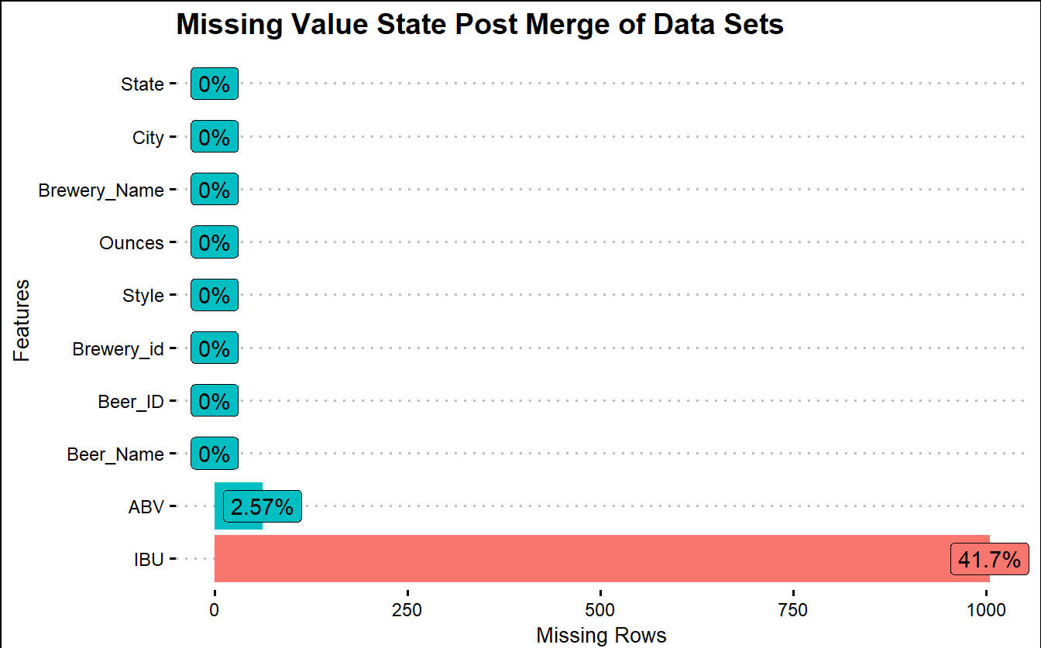
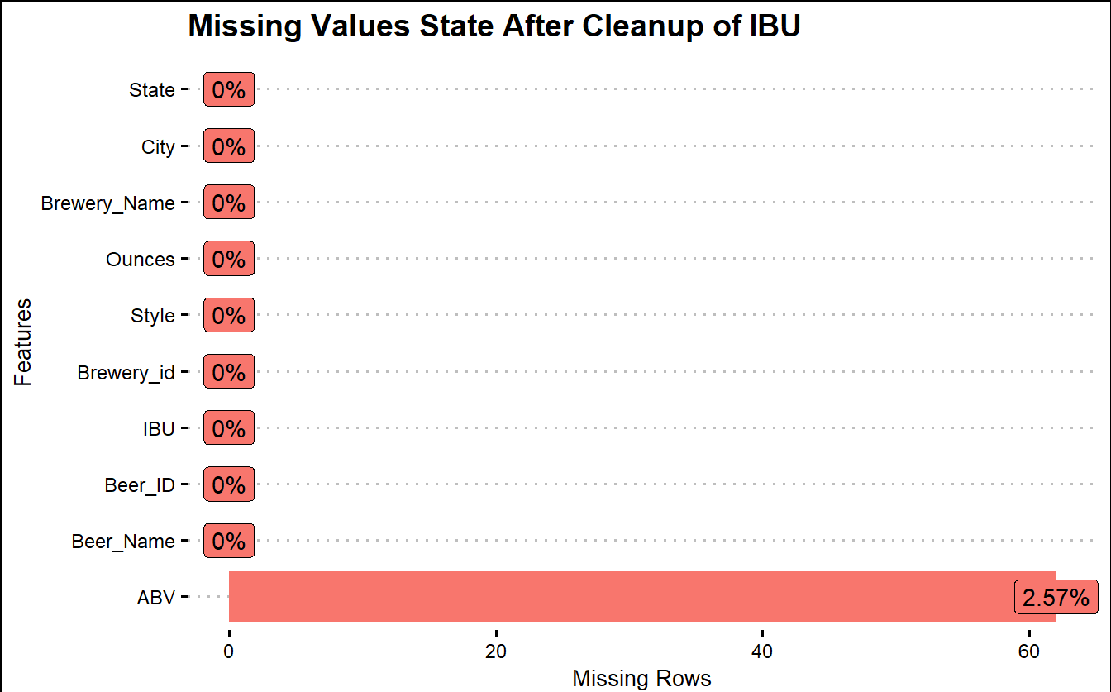
Missing Values
Notes:
Stretch, highlight, and add text. Add factoid about non-alcoholic beers especially for bud
Speaker: Rajesh
Notes: There are 62 (2.57%) observations where both ABV and IBU are empty, 943 (41.7%) observations where only IBU is empty.
For all observations that had both only IBU empty, the NA value was changed to zero since having a non-bitter alcoholic beer is possible. Whereas we choose not to include any observations that had zero ABV. That just isn’t a real beer. This leaves us with only 2.57% of the observations not being used.
This is how we addressed missing values, there are 2.6% of observations where both ABV and IBU are empty and 41.7% of total observations just IBU, which are empty. We made some realistic assumption that, a beer can exist without bitterness but probably not without alcohol. So, we have excluded all the ABV observations with NA’s and replaced IBU NA’s with zeros

Slide 5
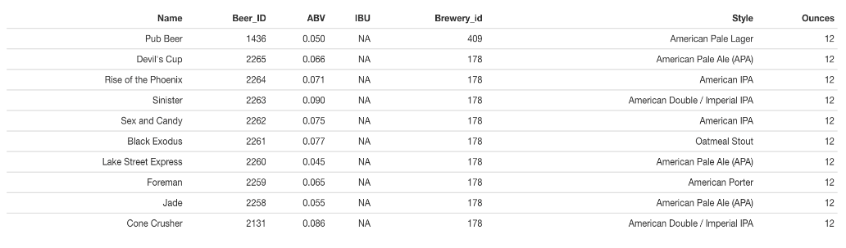
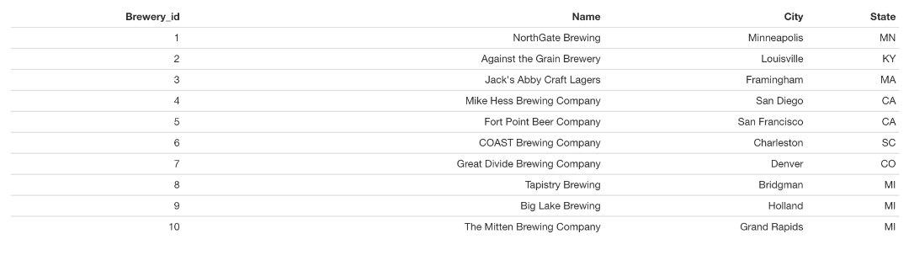
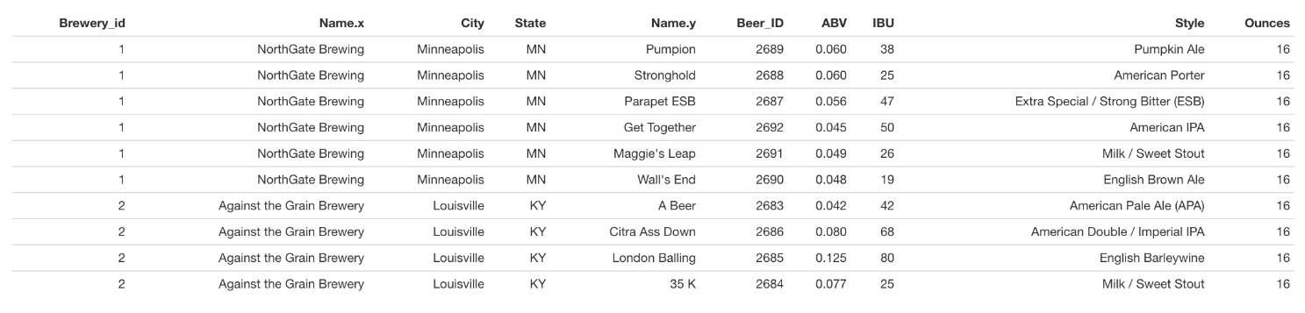
Merge beer and Brewery
Beer
Breweries
Notes:
CUT
Speaker: Kris
Notes: The two dataframes were merged by Brewery_id, which is common field for joining.
Prior to the merge, changing the column names was required to perform the merge.
Two records in the merged dataset had cities that were the same but misspelled. Both of those records were cleaned up so the city names were consistent.

Slide 6
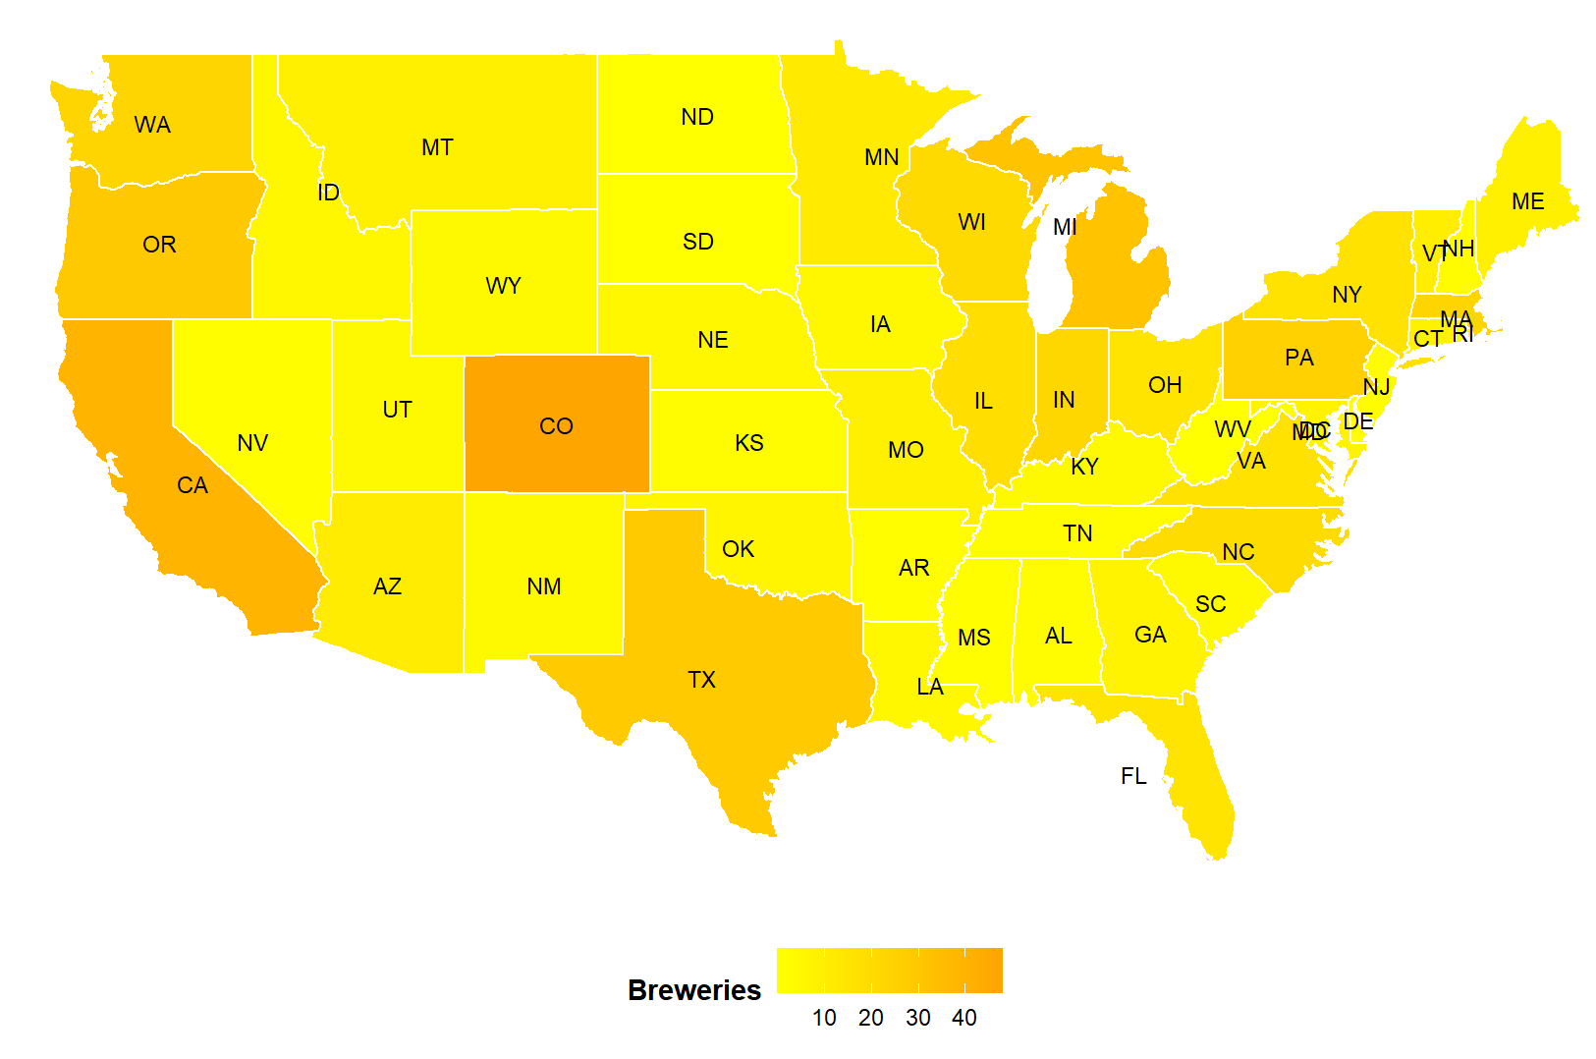
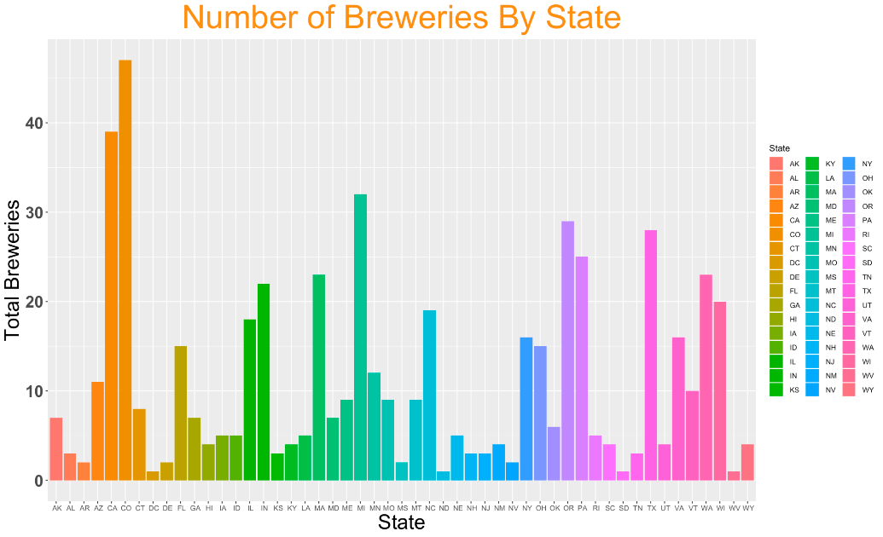
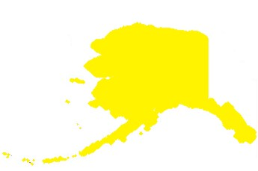
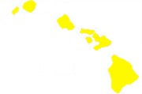
Breweries by State
47
39
28
AK
HI
Notes:
Highlight real stand out information. Factoids from the data and supporting points
Speaker: Kris
Notes: Colorado has the highest breweries of 47 which is 8 more than second highest California with 39 breweries.
4 states (DC, N Dakota, S Dakota, and West Virginia) only had 1 brewery
and 4 more states (Arkansas, Delaware, Mississippi, and Nevada) only have two breweries.
Nevada was a shock due to it being the home of Las Vegas. The highest number of breweries appears to be west of the Mississippi river. However, the northeast united states has its fair share.

Slide 7
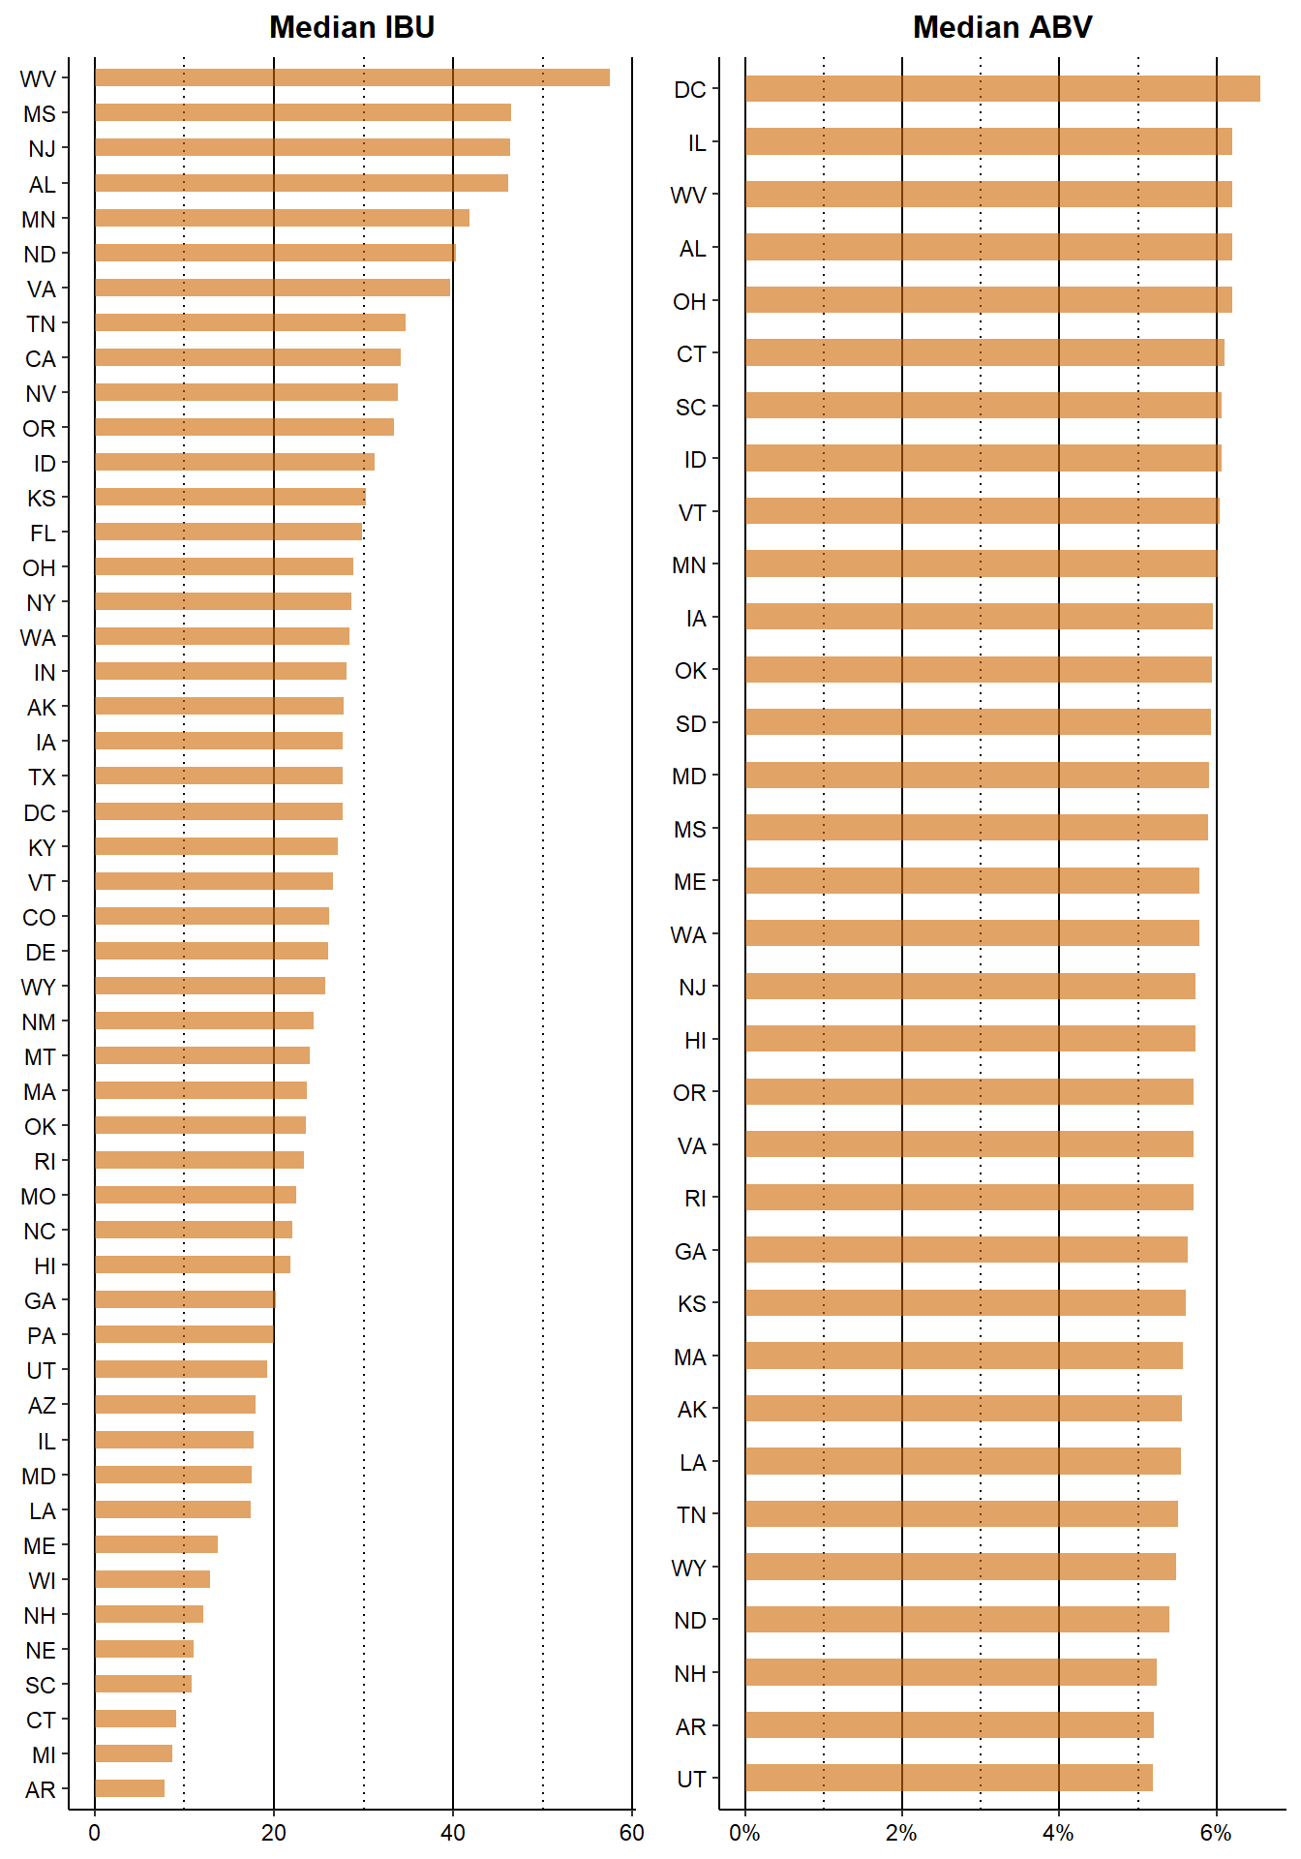
Median ABV and IBU
Notes:
Sort the data by values and add highlights
Speaker: Kris
Notes: The median ABV per state appears somewhat consistent with an overall ABV median of 0.056.
West Virginia has the highest median at 0.062 ABV and Utah has the lowest at 0.04 ABV.
The median IBU per state appears to vary considerably between states with an overall IBU median of 37.
West Virginia has the highest median at 57.5 IBU and Utah has the lowest at 6 IBU if you exclude the states with zero IBU.

Slide 8
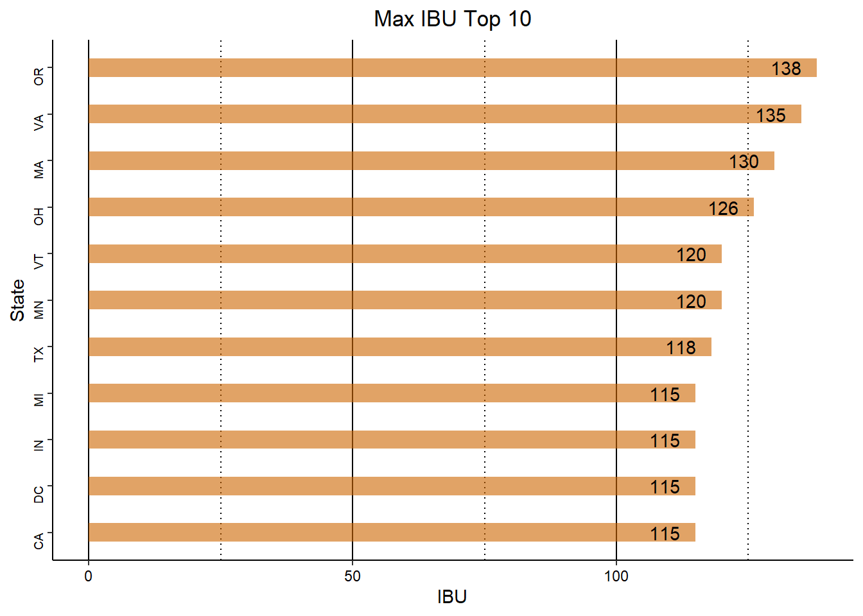
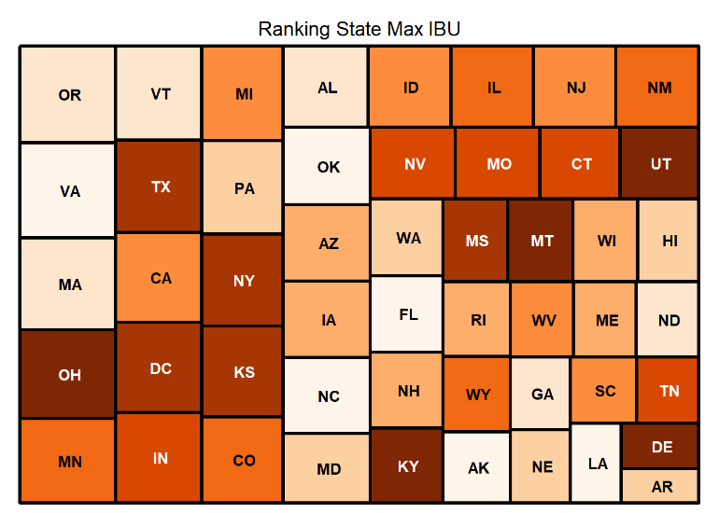
IBU Max
Notes:
Change titles to include MAX. callout the specific beers, get rid of matrix. Why?
Speaker: Thad Schwebke
Notes: The maximum IBU by state appears vary between states. Oregon has the highest Max IBU at 138 and Arkansas has the lowest at 44.11.

Slide 9
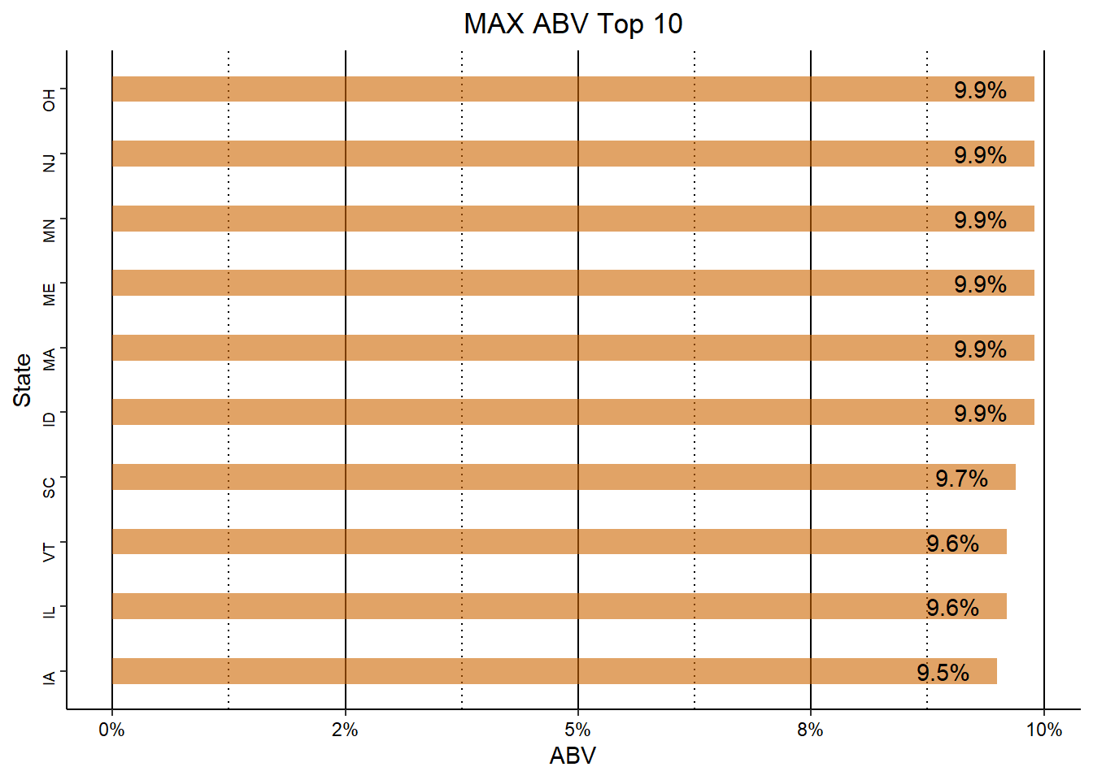
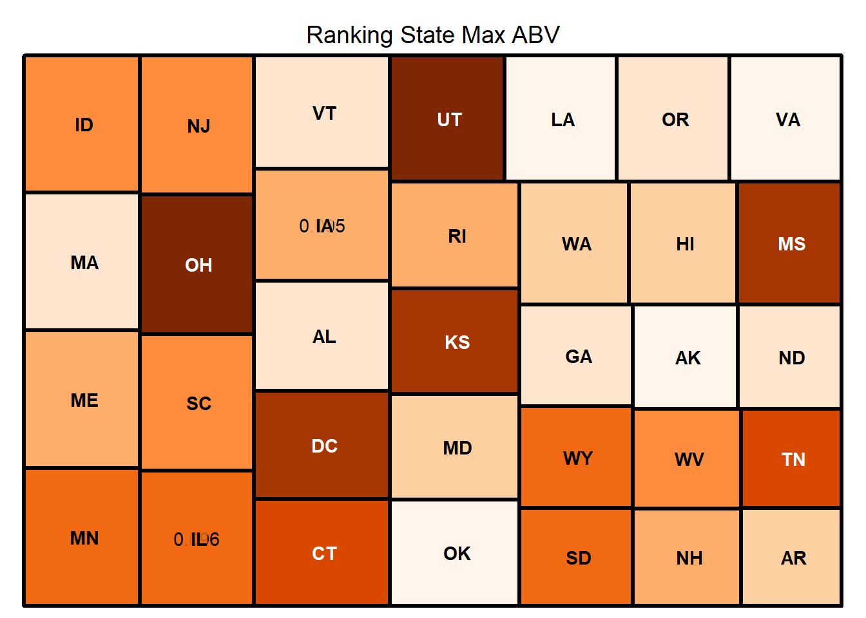
Max ABV
Notes:
Change titles to include MAX. callout the specific beers, get rid of matrix. Why?
Speaker: Thad Schwebke
Notes: The maximum ABV by state appears to have only a small variance between states. Colorado has the highest Max ABV at 0.128 and Delaware has the lowest at 0.055.

Slide 10
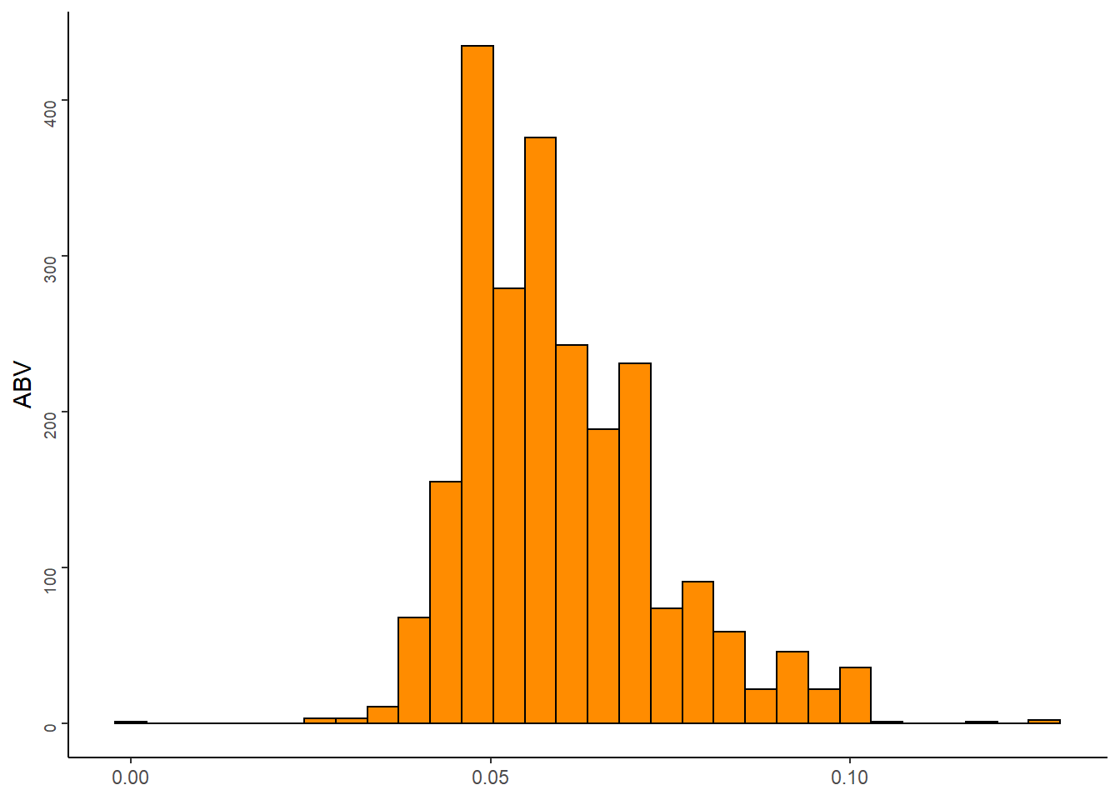
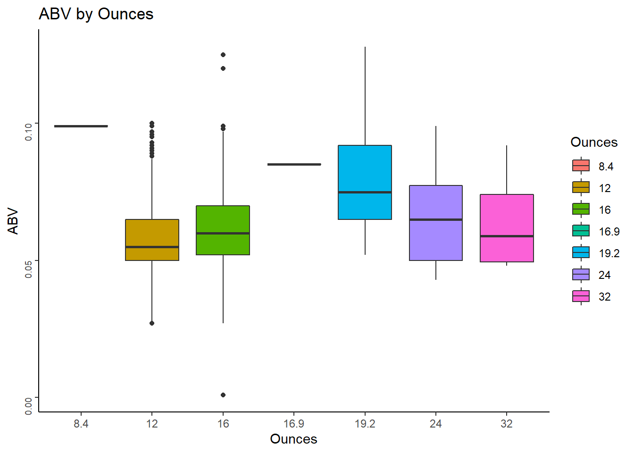
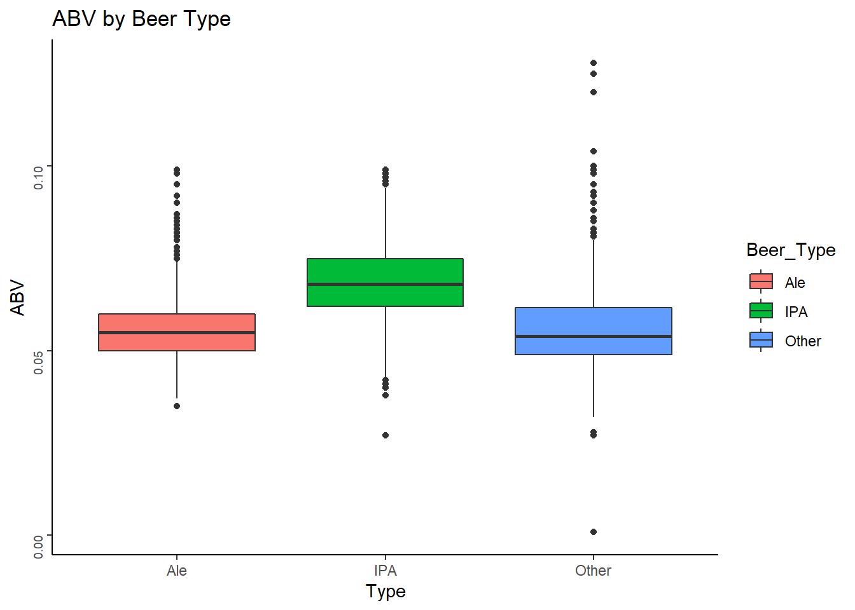
ABV Stats and Distribution
Notes:
Ask the question why for each chart
Speaker: Thad Schwebke
Notes: The distribution of frequencies of the data. A boxplot can give you information regarding the shape, variability, and center (or median) of a statistical data set. The histogram shows that the ABV data is normally distributed, but appears to have some small outliers on both ends. The two box plots illustrate that IPA has a higher overall median ABV at ~.8 ABV, however Other has several outliers that sit above the median (i.e. several greater than .12 ABV). 19.2 ounce beers tend to have the higher ABV, but the 16 ounces has a few outliers on the high side. One could also argue that 8.4 ounce beers has the highest median. The problem with this would be the number of observations that were 8.4 ounces. It appears to be a single observation.

Slide 11
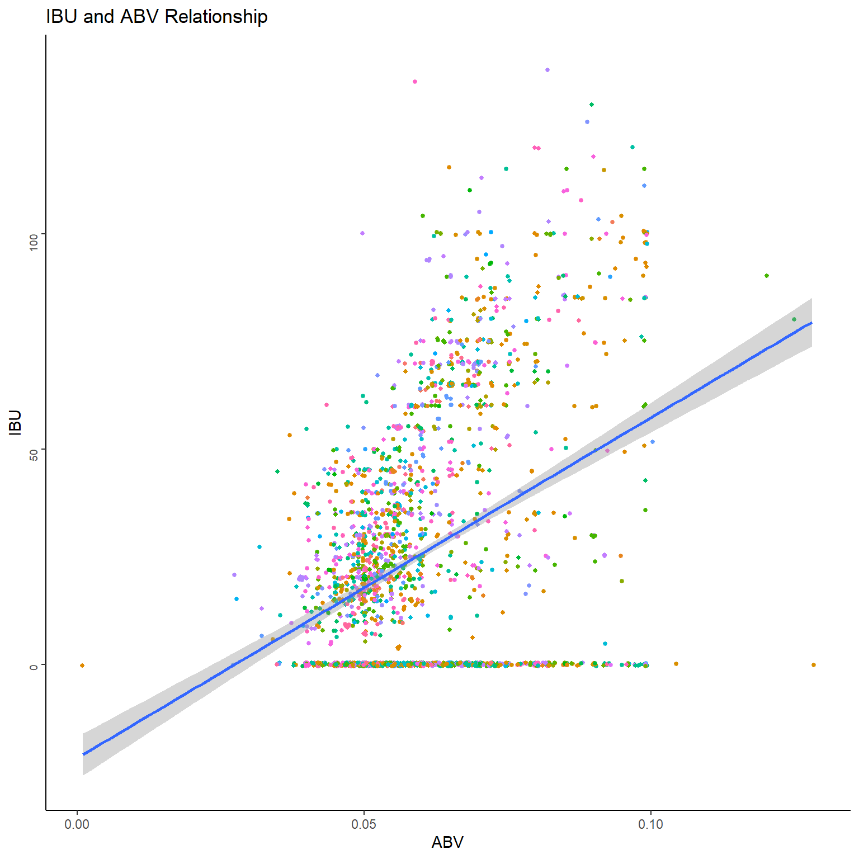
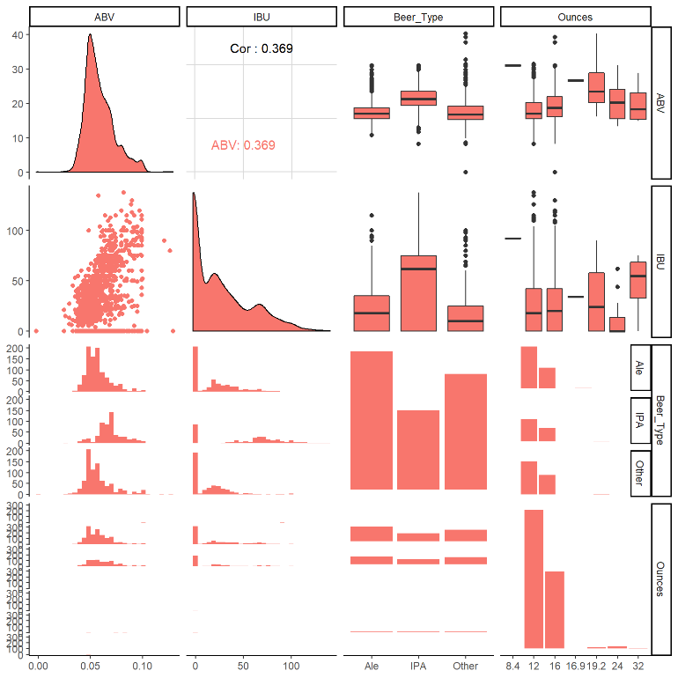
Relationship Between IBU and ABV
Notes:
Ask the question why for each chart
Speaker: Thad Schwebke
Notes: Scatter plots show how much one variable is affected by another. The relationship between two variables is called their correlation. The scatter plot illustrates what appears to be a positive linear relationship between the ABB and IBU. The addition of the trend line somewhat confirms the presence of a positive linear relationship between the ABV and IBU. More analysis would be needed to confirm.
Visualizing the relationship between multiple variables
•Scatterplots correlation coefficients are also providing in the same panel.
•Density plots for every numeric continuous variable help us to identify skewness, kurtosis and distribution information.
•Box plots are used to represent statistical summary for categorical and respective numeric variable.

Slide 12
Thank You!

